Slide 1
Protostellar polarization with CARMA Greatest hits
Chat Hull
University of California, Berkeley
Radio Astronomy Laboratory
10 September 2013
Seminar
ICN, UNAM – Mexico City Campus
Coyoacán, Distrito Federal, México
Notes:
Star formation regions

Slide 2
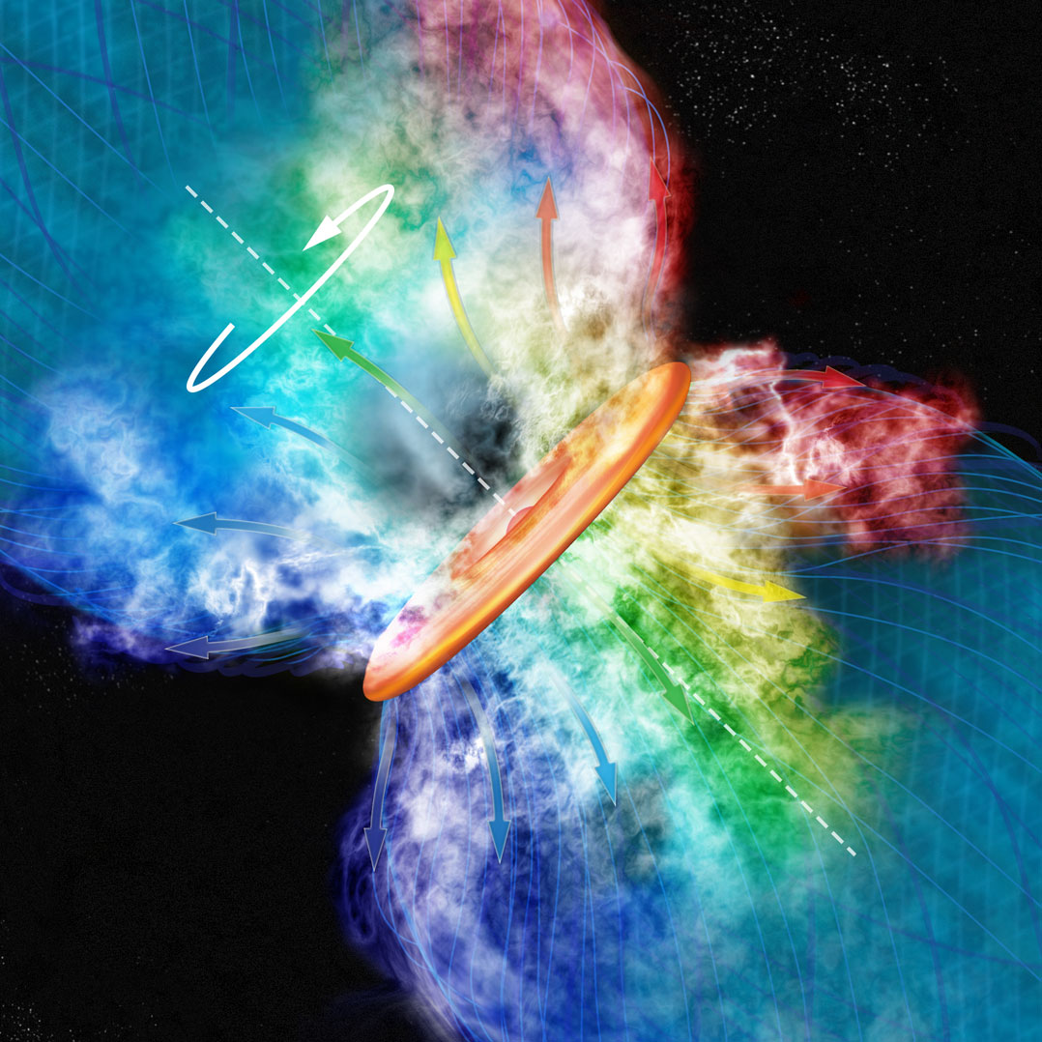
Credit: Bill Saxton, CfA

Slide 3
Multi-scale comparisons: B-fields vs. outflows
1 pc
0.1 pc
1000 AU
100 AU
RANDOM
Ménard & Duchêne 2004
Targon+ 2011

Slide 4
Multi-scale comparisons: B-fields vs. outflows
1 pc
0.1 pc
1000 AU
100 AU
RANDOM
Curran & Chrysostomou 2007

Slide 5
Multi-scale comparisons: B-fields vs. outflows
1 pc
0.1 pc
1000 AU
100 AU
RANDOM
Or preferentially ⟂ ?
Hull+ 2013a

Slide 6
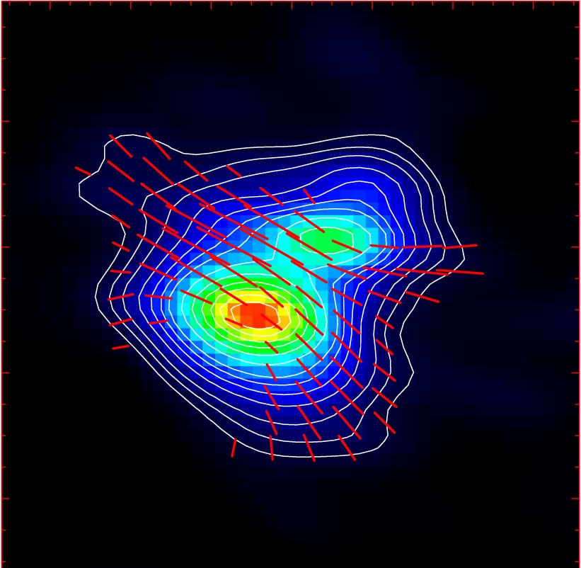
Misalignment of B-fields and outflows
IRAS 16293
NGC 1333-IRAS 4A
B-field
Rao+ 2009
Girart+ 2006
Outflow
Notes:
ROTATION: IRAS 16293 has rot/grav < 0.1; IRAS4A seems the same (barely any rotation); VLA 1623 questionable (probably slow)
-Holland: JCMT data
-Rao, Girart: SMA
-This is okay, according to Hennebelle & Ciardi ‘09 (easier to form disks with obliquity!)
-Ward-Thompson et al (2009) saw a 30 deg offset between short axes of cores and their polarization directions…another problem!

Slide 7
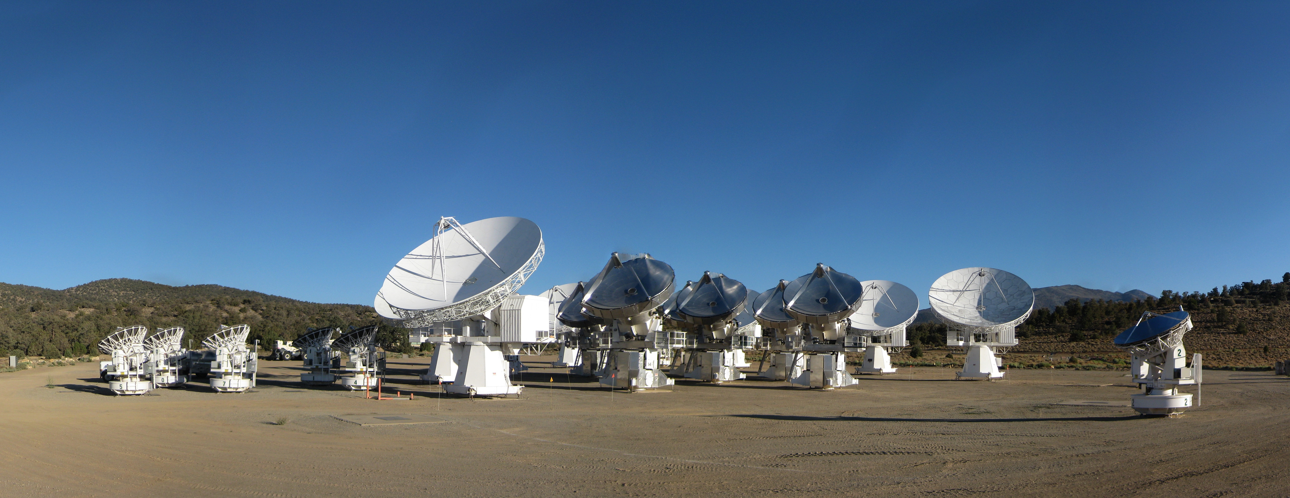
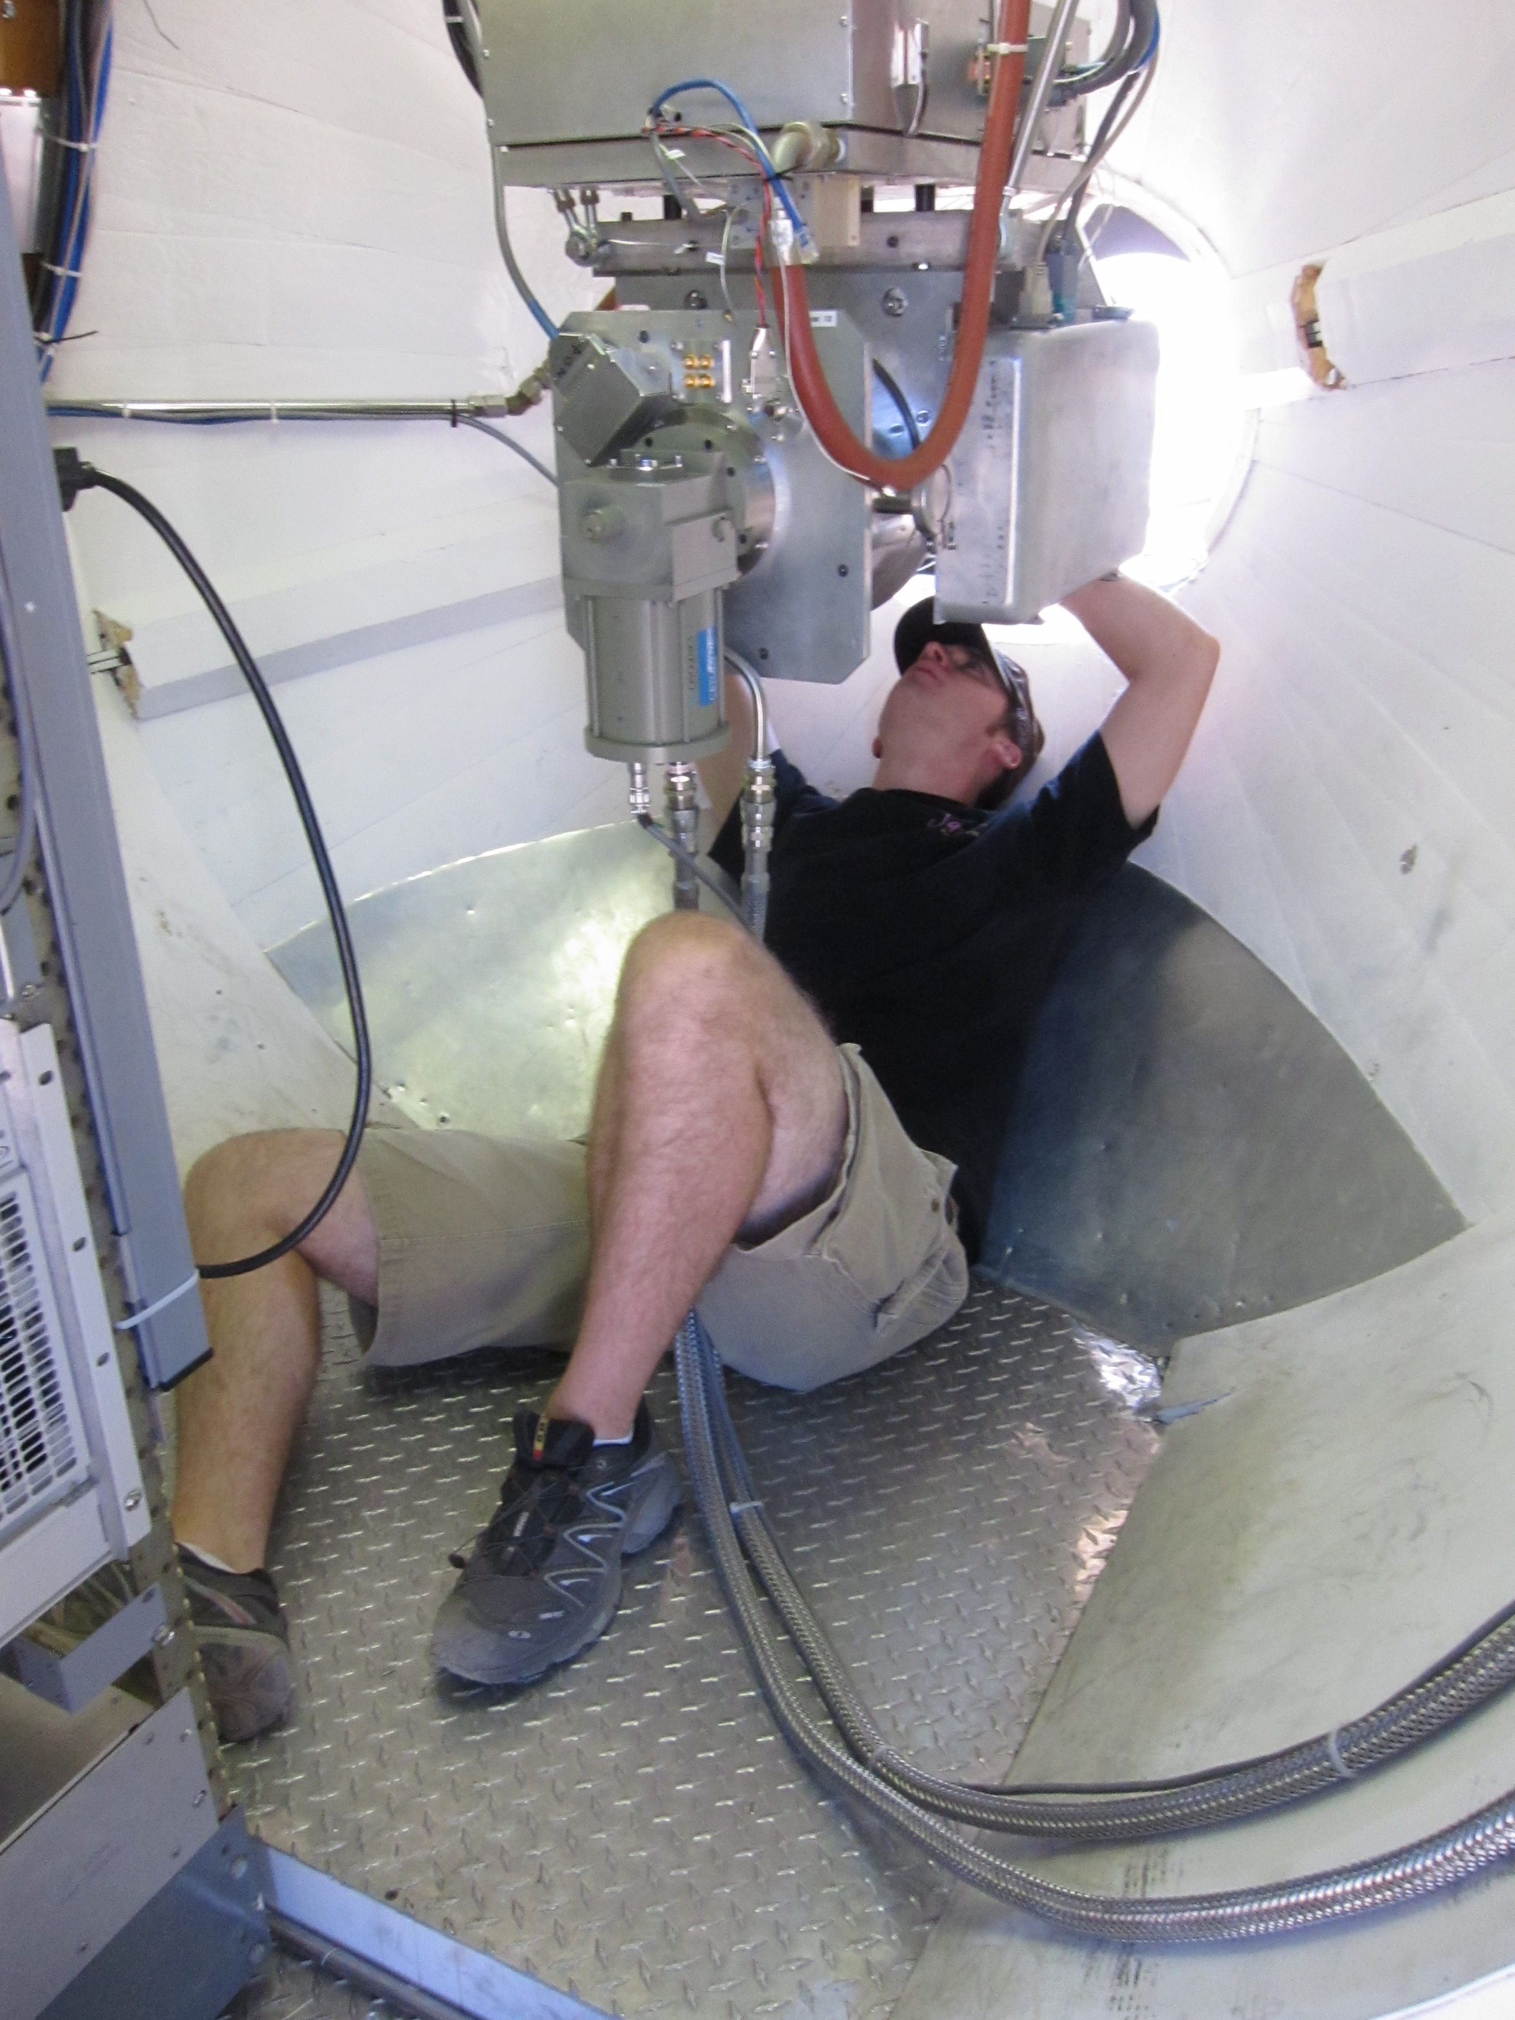
CARMA Combined Array for Research in Millimeter-wave Astronomy Consortium: Berkeley, Caltech, Illinois, Maryland, Chicago
6 ⨯10-m, 9 ⨯ 6-m, 8 ⨯ 3.5-m telescopes
Observations at 1 cm, 3 mm, and 1 mm (polarization!)
Located in Cedar Flat, CA (near Bishop)
Notes:
SMA: 8*6m antennas = 226 m^2
CARMA: 6*10m, 9*6m = 726 m^2 (more than factor of 3 more area)
-Factor of two more dishes
-Equivalent T_sys?

Slide 8
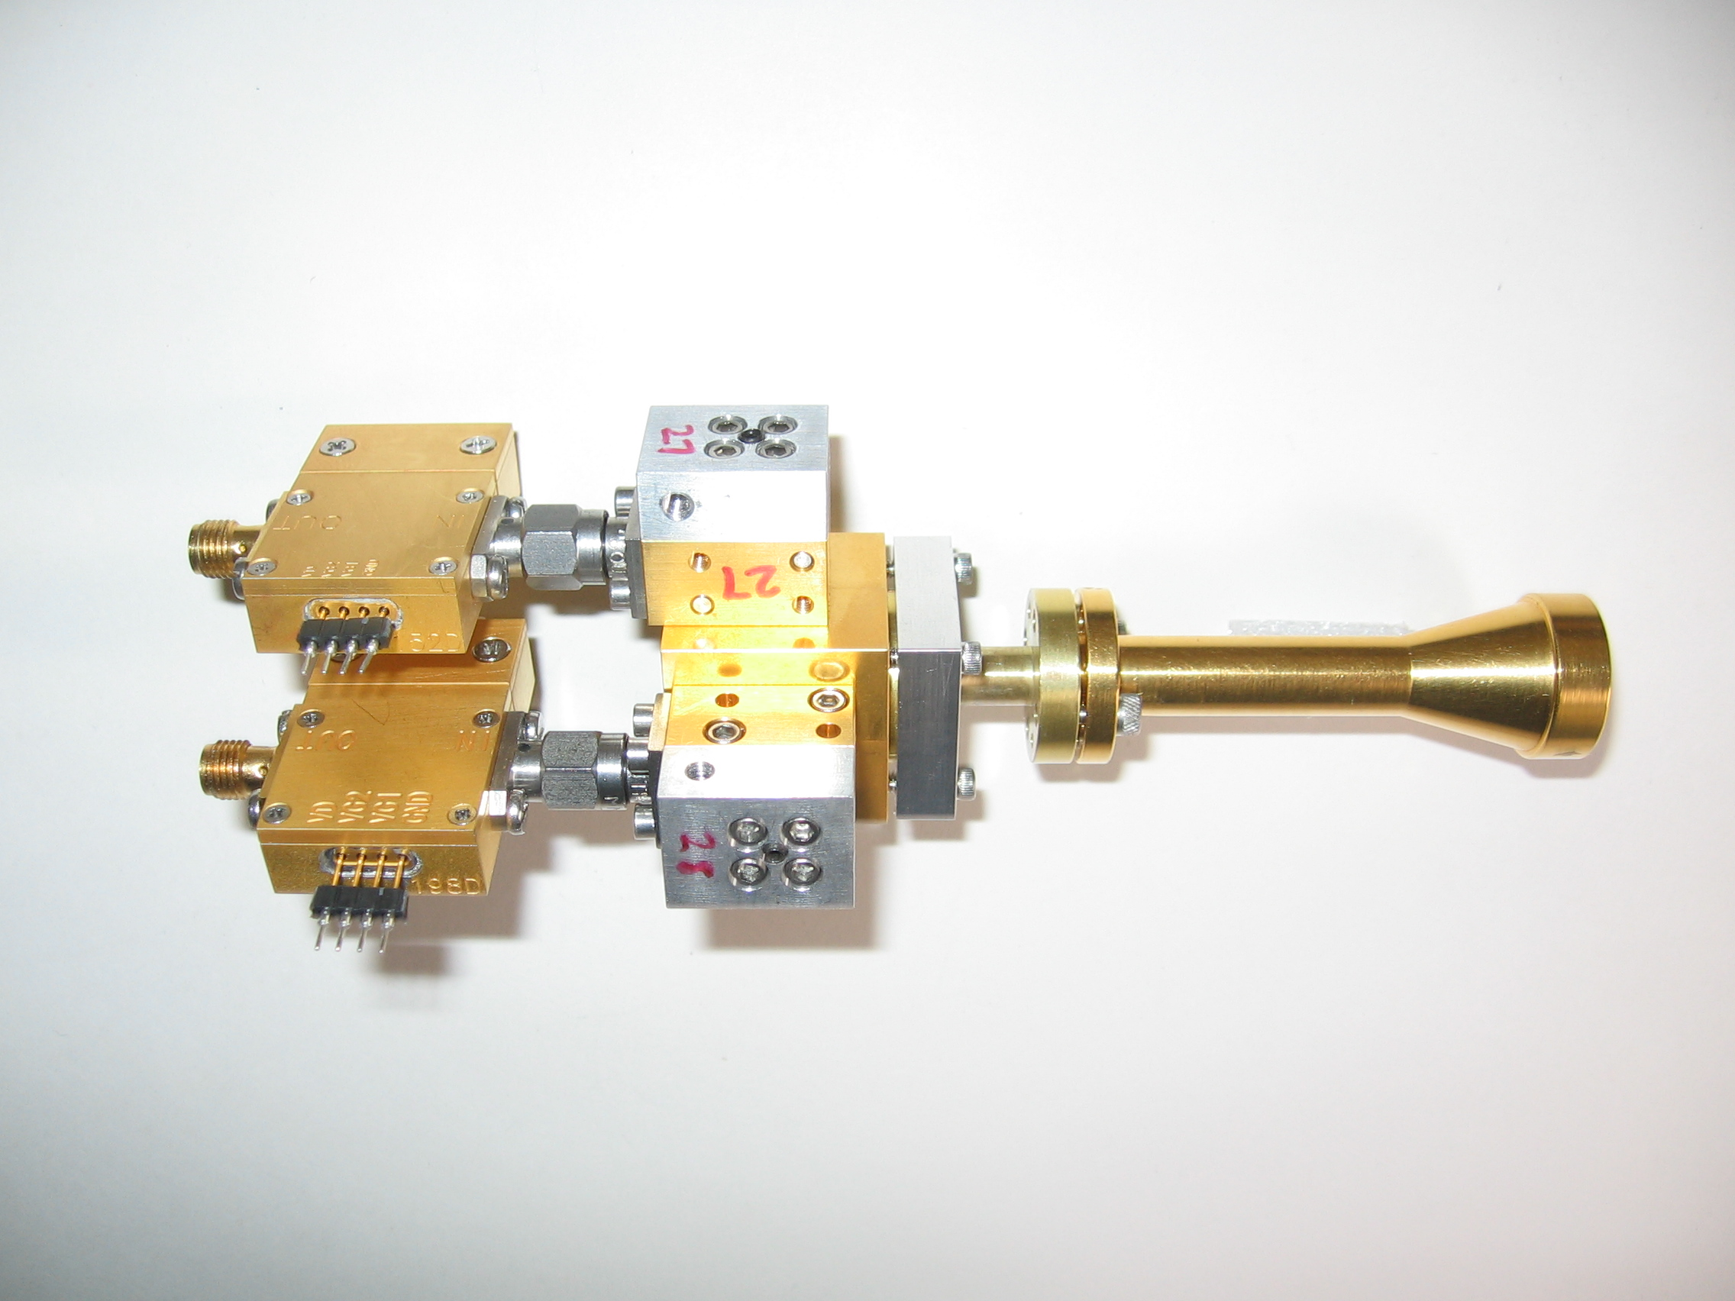
1 mm dual-polarization receivers
SIS mixers
Orthomode transducer
Waveguide circular polarizer
1 inch
WBA13
I.F. amplifiers (1-9 GHz)
Credit: Dick Plambeck
Notes:
-Sensitive to RCP & LCP
-Null experiment: in the absence of linear polarization, you get no RL correlation at any time.
-If you have linear feeds, you have XY correlation sometimes (when the intrinsic polarization is at 45º to your two feeds), and not other times (when it’s along one feed or the other). Thus, to tease out the polarization, you need stable gains

Slide 9
TADPOL results
L1157
2″
See also: Stephens+ 2013, ApJL, 769, L15
Notes:
NEARBY SF regions:
-Perseus (NGC 1333, L1448, SVS13): 235 pc (masers in SVS13) → 03:30 LST
-Taurus (DG Tau, L1527): 140 pc → 04:30 LST
-Orion: 400 pc → 05:30 LST
-Serpens: 415 pc → 18:30 LST
-Ophiuchus: 140 pc → 17:00 LST
-Cepheus (L1157): 250 pc → 22:00 LST
-Isolated (B335, Bok globule): 250 pc

Slide 10
TADPOL results
NGC 1333-IRAS 4A
NGC 1333-IRAS 4B
4B
4B2
2″
2″
Notes:
NEARBY SF regions:
-Perseus (NGC 1333, L1448, SVS13): 235 pc (masers in SVS13) → 03:30 LST
-Taurus (DG Tau, L1527): 140 pc → 04:30 LST
-Orion: 400 pc → 05:30 LST
-Serpens: 415 pc → 18:30 LST
-Ophiuchus: 140 pc → 17:00 LST
-Cepheus (L1157): 250 pc → 22:00 LST
-Isolated (B335, Bok globule): 250 pc

Slide 11
TADPOL results
L1527
NGC 1333-IRAS 2A
2″
3″
Notes:
NEARBY SF regions:
-Perseus (NGC 1333, L1448, SVS13): 235 pc (masers in SVS13) → 03:30 LST
-Taurus (DG Tau, L1527): 140 pc → 04:30 LST
-Orion: 400 pc → 05:30 LST
-Serpens: 415 pc → 18:30 LST
-Ophiuchus: 140 pc → 17:00 LST
-Cepheus (L1157): 250 pc → 22:00 LST
-Isolated (B335, Bok globule): 250 pc

Slide 12
TADPOL results
Ser-emb 8
3″
Notes:
NEARBY SF regions:
-Perseus (NGC 1333, L1448, SVS13): 235 pc (masers in SVS13) → 03:30 LST
-Taurus (DG Tau, L1527): 140 pc → 04:30 LST
-Orion: 400 pc → 05:30 LST
-Serpens: 415 pc → 18:30 LST
-Ophiuchus: 140 pc → 17:00 LST
-Cepheus (L1157): 250 pc → 22:00 LST
-Isolated (B335, Bok globule): 250 pc

Slide 13
Outflow vs. B-field: distribution
Simulation: outflows & B-fields aligned within a 20º cone (tightly aligned)
Simulation: outflows & B-fields are randomly oriented
CDF
Simulation: outflows & B-fields aligned between 70–90º (preferentially misaligned)
KS-test results:
20º cone ruled out ( p-value ~ 10⁻¹⁵ )
Misaligned ( 0.33 ) and random ( 0.33 ) cannot be ruled out
Hull+ 2013a, ApJ, 768, 159
(plot updated Aug ‘13)
𝜽_{outflow} – 𝜽_{B-field} (deg)

Slide 14
Multi-scale comparisons: B-fields
> 1 pc
0.1 pc
1000 AU
100 AU
CONSISTENT
Hua-bai Li+ 2009

Slide 15
Multi-scale comparisons: B-fields
1 pc
0.1 pc
1000 AU
100 AU
(Not always) consistent
Hull+ 2013b (in prep)
Chapman+ 2013

Slide 16
Cores with consistent large-to-small B-fields
NGC 1333-IRAS 4A
Notes:
Other TADPOL future possibilities:
Intrinsic modeling of B-fields in cores (Fiege)
Constraints on B-fields in protoplanetary disks (Hughes)
Turbulence power spectra (Houde)
Larger scale background-star maps (Mimir, Jameson/Pillai/Clemens)

Slide 17
Cores with consistent large-to-small B-fields
NGC 1333-IRAS 4A
Notes:
Other TADPOL future possibilities:
Intrinsic modeling of B-fields in cores (Fiege)
Constraints on B-fields in protoplanetary disks (Hughes)
Turbulence power spectra (Houde)
Larger scale background-star maps (Mimir, Jameson/Pillai/Clemens)

Slide 18
Cores with consistent large-to-small B-fields
HH 211
Notes:
Other TADPOL future possibilities:
Intrinsic modeling of B-fields in cores (Fiege)
Constraints on B-fields in protoplanetary disks (Hughes)
Turbulence power spectra (Houde)
Larger scale background-star maps (Mimir, Jameson/Pillai/Clemens)

Slide 19
Cores with consistent large-to-small B-fields
HH 211
Notes:
Other TADPOL future possibilities:
Intrinsic modeling of B-fields in cores (Fiege)
Constraints on B-fields in protoplanetary disks (Hughes)
Turbulence power spectra (Houde)
Larger scale background-star maps (Mimir, Jameson/Pillai/Clemens)

Slide 20
Cores with INconsistent large-to-small B-fields
Ser-emb 6
Notes:
Other TADPOL future possibilities:
Intrinsic modeling of B-fields in cores (Fiege)
Constraints on B-fields in protoplanetary disks (Hughes)
Turbulence power spectra (Houde)
Larger scale background-star maps (Mimir, Jameson/Pillai/Clemens)

Slide 21
Cores with INconsistent large-to-small B-fields
Ser-emb 6
See also: Chapman+13
Notes:
Other TADPOL future possibilities:
Intrinsic modeling of B-fields in cores (Fiege)
Constraints on B-fields in protoplanetary disks (Hughes)
Turbulence power spectra (Houde)
Larger scale background-star maps (Mimir, Jameson/Pillai/Clemens)

Slide 22
Cores with INconsistent large-to-small B-fields
L1527
Notes:
Other TADPOL future possibilities:
Intrinsic modeling of B-fields in cores (Fiege)
Constraints on B-fields in protoplanetary disks (Hughes)
Turbulence power spectra (Houde)
Larger scale background-star maps (Mimir, Jameson/Pillai/Clemens)

Slide 23
Cores with INconsistent large-to-small B-fields
L1527
Notes:
Other TADPOL future possibilities:
Intrinsic modeling of B-fields in cores (Fiege)
Constraints on B-fields in protoplanetary disks (Hughes)
Turbulence power spectra (Houde)
Larger scale background-star maps (Mimir, Jameson/Pillai/Clemens)

Slide 24
Alignment vs. polarization fraction
• Core
⨉ Star-forming region
LO-POL
𝜽_{small} – 𝜽_{large} (deg)
HI-POL
Average P_{frac}
Hull+ 2013b (in prep)

Slide 25
Cores: two populations
HI-POL
(P ≈ 3 – 6%)
B_{sm} ∥B_{lg}
Outflows random w.r.t. B_{sm}
LO-POL
(P ≲ 3%)
B_{sm} ∦ B_{lg}
Outflows ⟂ B_{sm}

Slide 26
Multi-scale comparisons: B-fields vs. outflows
1 pc
0.1 pc
1000 AU
100 AU
RANDOM
Or preferentially ⟂ ?
Hull+ 2013a

Slide 27
Multi-scale comparisons: B-fields vs. outflows
1 pc
0.1 pc
1000 AU
100 AU
Random (HI-POL)
⟂ (LO-POL)

Slide 28
Cores: B-field vs. outflow alignment
CDF
ALL CORES
(random/misaligned?)
Hull+ 2013b (in prep)
𝜽_{outflow} – 𝜽_{B-field} (deg)

Slide 29
Cores: B-field vs. outflow alignment
CDF
HI-POL
(random)
Hull+ 2013b (in prep)
𝜽_{outflow} – 𝜽_{B-field} (deg)

Slide 30
Cores: B-field vs. outflow alignment
CDF
LO-POL
(misaligned)
Hull+ 2013b (in prep)
𝜽_{outflow} – 𝜽_{B-field} (deg)

Slide 31
HI-POL: B-fields random w.r.t. outflows
IRAS 4A
HH 211
B-field
Outflow
OMC3-MMS6
Notes:
Other TADPOL future possibilities:
Intrinsic modeling of B-fields in cores (Fiege)
Constraints on B-fields in protoplanetary disks (Hughes)
Turbulence power spectra (Houde)
Larger scale background-star maps (Mimir, Jameson/Pillai/Clemens)

Slide 32
LO-POL: B-fields ⟂ outflows
VLA 1623
L1527
IRAS 4B
Ser-emb 8
B-field
Outflow
Notes:
Other TADPOL future possibilities:
Intrinsic modeling of B-fields in cores (Fiege)
Constraints on B-fields in protoplanetary disks (Hughes)
Turbulence power spectra (Houde)
Larger scale background-star maps (Mimir, Jameson/Pillai/Clemens)

Slide 33
HI-POL vs. LO-POL: open questions
HI-POL
Are they younger objects?
Is our view is just dominated by the global field?
Are the fields actually twisted at smaller scales?
LO-POL
Are they older objects?
Are the twisted fields we see at 1000 AU consistent with disk scales?

Slide 34
FUTURE multi-scale comparison: B-fields
?
1 pc
0.1 pc
1000 AU
100 AU
Machida+ 2006
CARMA/SMA +
ALMA

Slide 35
Alignment vs. polarization fraction
• Core
⨉ Star-forming region
SFRs
𝜽_{small} – 𝜽_{large} (deg)
Average P_{frac}
Hull+ 2013b (in prep)

Slide 36
Star-forming regions
DR21(OH)
Notes:
Other TADPOL future possibilities:
Intrinsic modeling of B-fields in cores (Fiege)
Constraints on B-fields in protoplanetary disks (Hughes)
Turbulence power spectra (Houde)
Larger scale background-star maps (Mimir, Jameson/Pillai/Clemens)

Slide 37
Star-forming regions
DR21(OH)
Notes:
Other TADPOL future possibilities:
Intrinsic modeling of B-fields in cores (Fiege)
Constraints on B-fields in protoplanetary disks (Hughes)
Turbulence power spectra (Houde)
Larger scale background-star maps (Mimir, Jameson/Pillai/Clemens)

Slide 38
Star-forming regions
NGC 7538
Notes:
Other TADPOL future possibilities:
Intrinsic modeling of B-fields in cores (Fiege)
Constraints on B-fields in protoplanetary disks (Hughes)
Turbulence power spectra (Houde)
Larger scale background-star maps (Mimir, Jameson/Pillai/Clemens)

Slide 39
Star-forming regions
NGC 7538 IRS 1
Notes:
Other TADPOL future possibilities:
Intrinsic modeling of B-fields in cores (Fiege)
Constraints on B-fields in protoplanetary disks (Hughes)
Turbulence power spectra (Houde)
Larger scale background-star maps (Mimir, Jameson/Pillai/Clemens)

Slide 40
Star-forming regions
W3(OH)
Notes:
Other TADPOL future possibilities:
Intrinsic modeling of B-fields in cores (Fiege)
Constraints on B-fields in protoplanetary disks (Hughes)
Turbulence power spectra (Houde)
Larger scale background-star maps (Mimir, Jameson/Pillai/Clemens)

Slide 41
Star-forming regions
W3(OH)
Notes:
Other TADPOL future possibilities:
Intrinsic modeling of B-fields in cores (Fiege)
Constraints on B-fields in protoplanetary disks (Hughes)
Turbulence power spectra (Houde)
Larger scale background-star maps (Mimir, Jameson/Pillai/Clemens)

Slide 42
Star-forming regions
W3 Main
Notes:
Other TADPOL future possibilities:
Intrinsic modeling of B-fields in cores (Fiege)
Constraints on B-fields in protoplanetary disks (Hughes)
Turbulence power spectra (Houde)
Larger scale background-star maps (Mimir, Jameson/Pillai/Clemens)

Slide 43
Star-forming regions
W3 Main
Notes:
Other TADPOL future possibilities:
Intrinsic modeling of B-fields in cores (Fiege)
Constraints on B-fields in protoplanetary disks (Hughes)
Turbulence power spectra (Houde)
Larger scale background-star maps (Mimir, Jameson/Pillai/Clemens)

Slide 44
Fin

